Slide 1
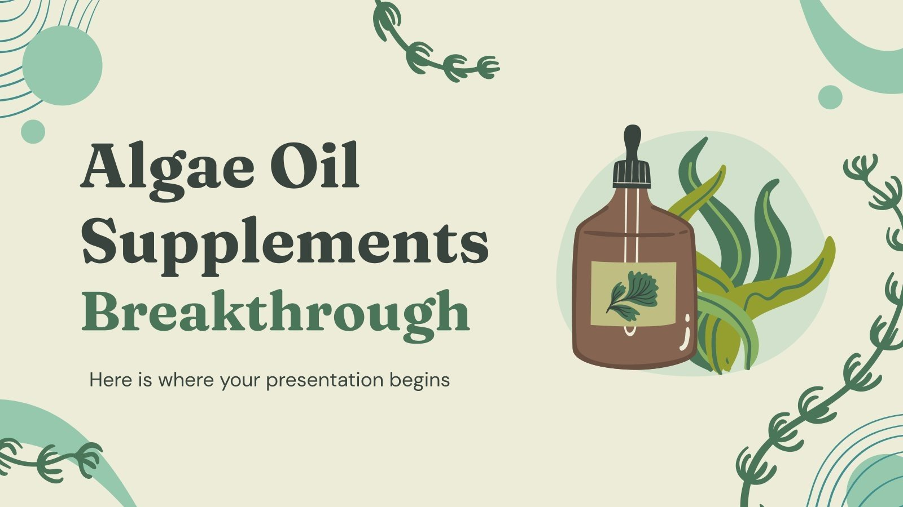
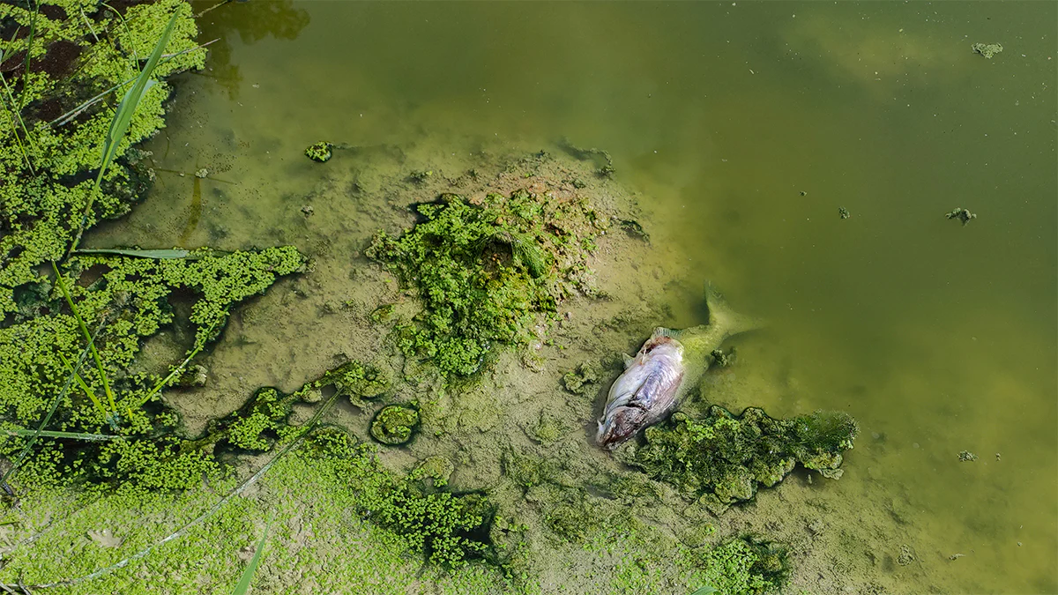
Combating Toxic Algae Blooms
`
`
10/20/2024
Daniel Chen, Anton Del Mar, Peter Quawas
The Algae Fighters

Slide 2
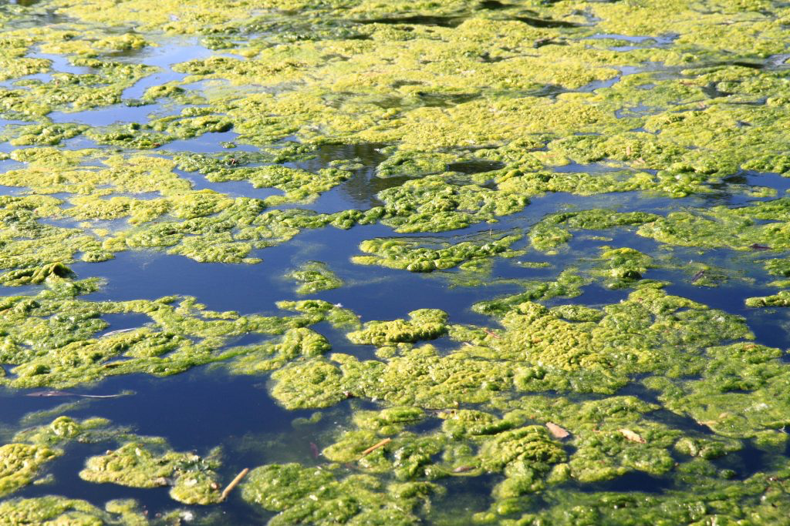
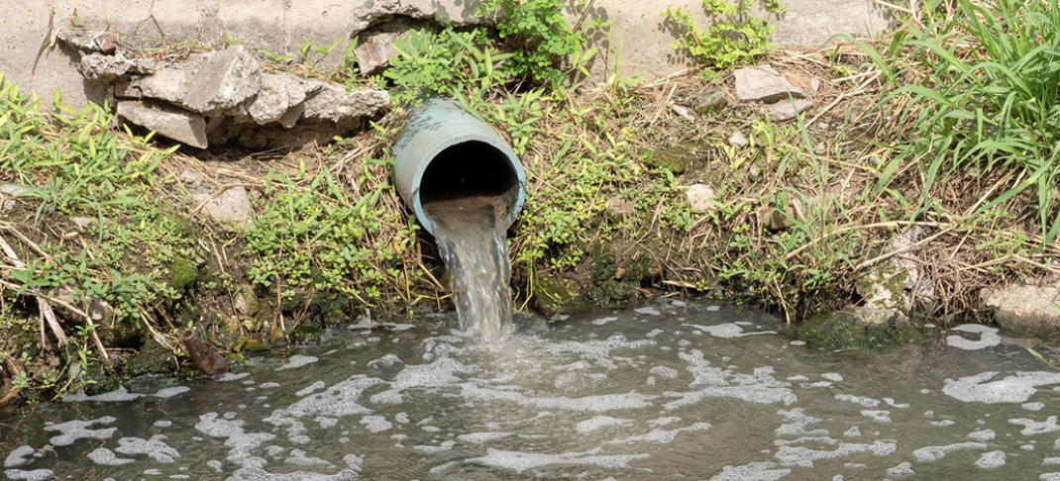
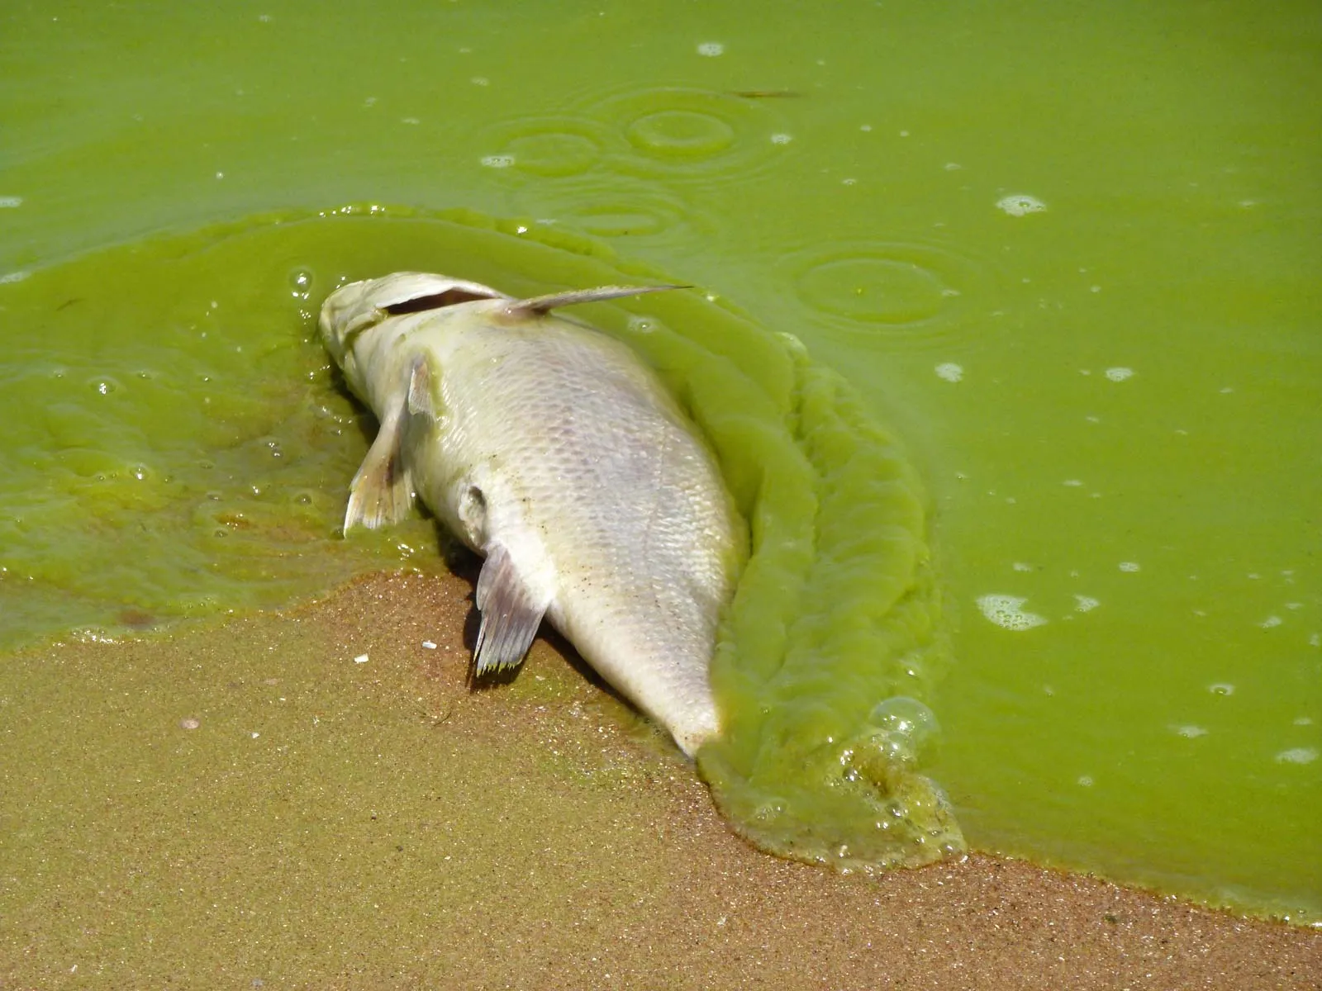
Problem Definition
Fertilizer runoff causes toxic algae to bloom which poisons water supplies and kills marine life.

Slide 3
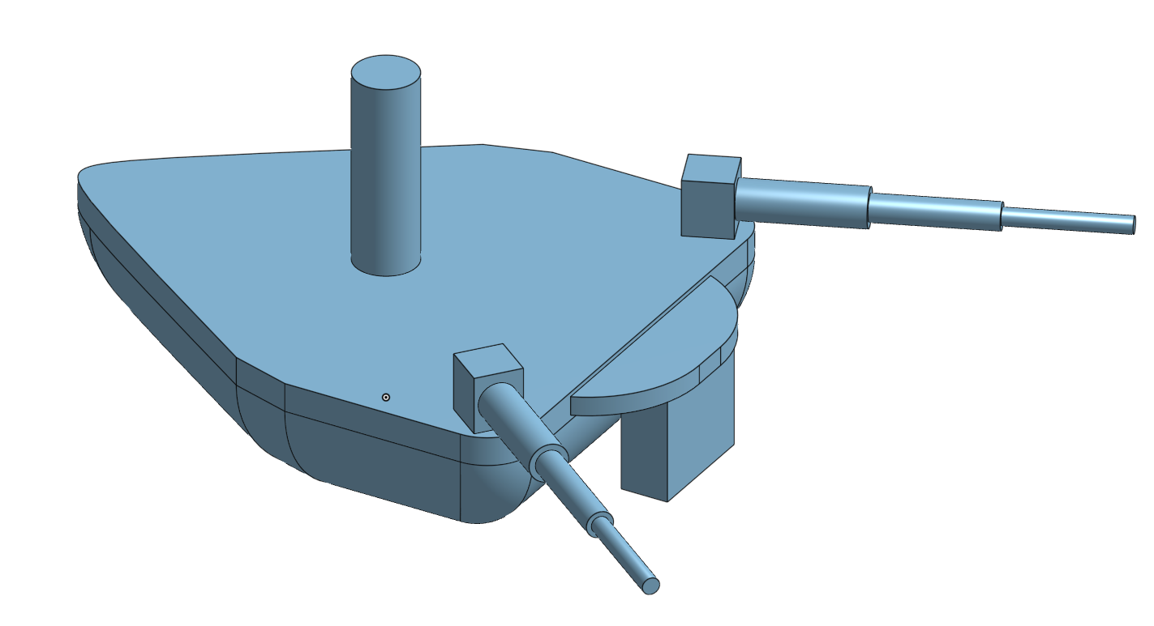
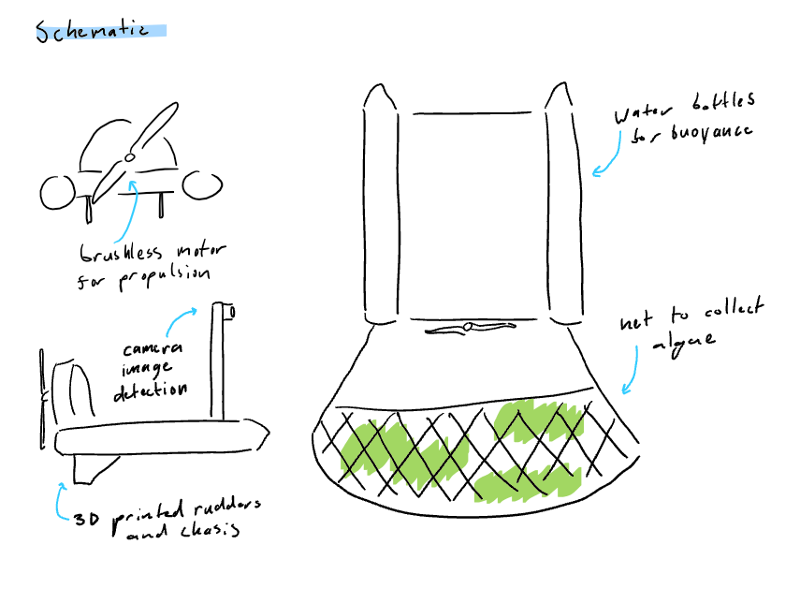
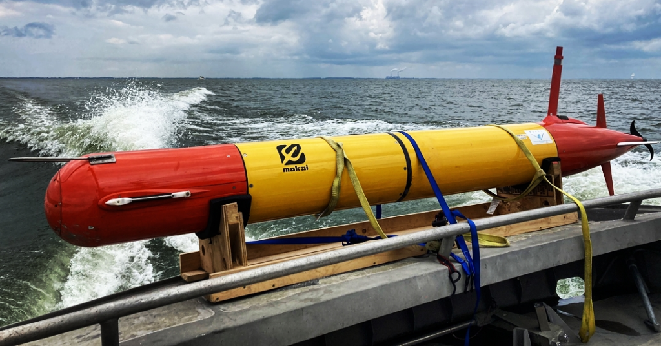
Proposed Idea
Telescoping arms for the net
Tall mount for camera
Boat-shaped body
Mount for Propellers
Using image recognition our robot will automatically detect Algae and collect it for removal from the lake.

Slide 4
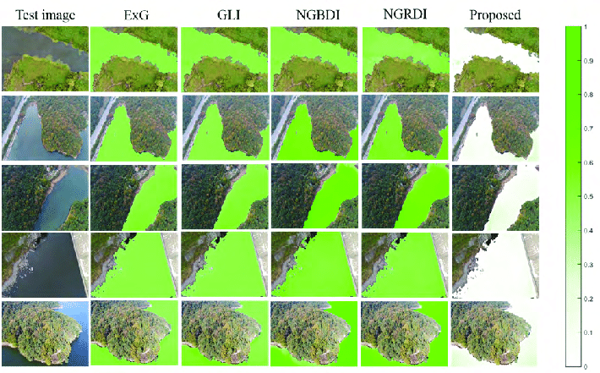
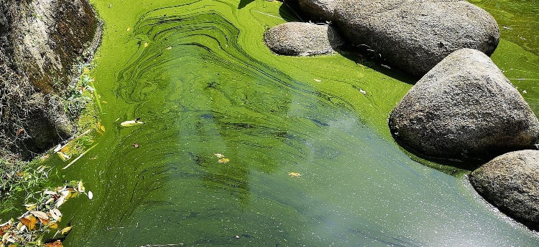
Testable Hypothesis
We will be able to create an image recognition algorithm that would be able to find algae in a body of water.
Our robot will be able to use said algorithm to then efficiently clean up spots of algae from a small pool of water.
This will provide proof of concept on a small scale which can then be iterated on for larger bodies of water.
How can you show, this quarter, that your device solves the problem?

Slide 5
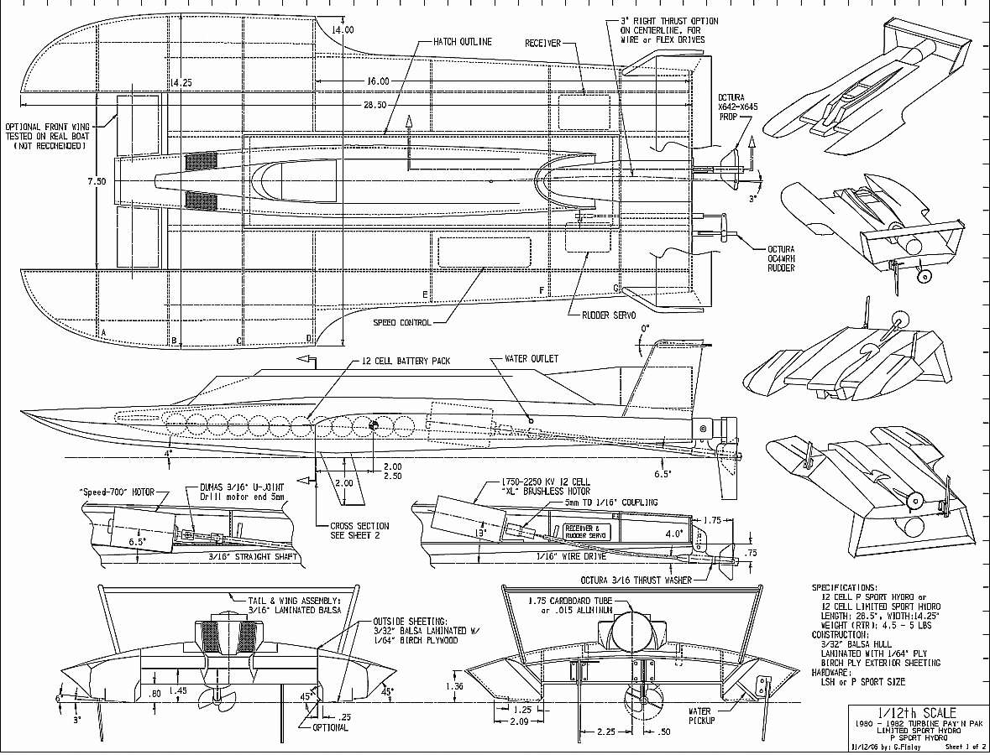
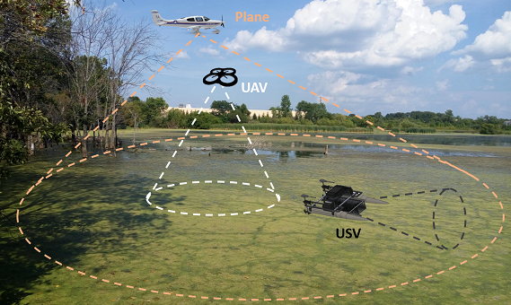
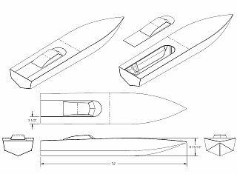
Milestones - Achievable Goals
Achievable Goals
Image Recognition - Create a simple image recognition program that can distinguish the difference between algae and the body of water it is on as well as any other foreign objects.
Building Boat Body - Construct a boat that is capable of skimming over the water whilst having enough power to drag a net that can collect algae.
RC Boat Body Schematic
Boat Body Schematic
Algae Detection Computer Vision

Slide 6
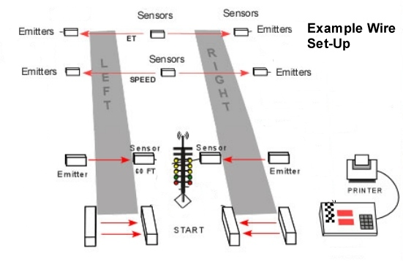
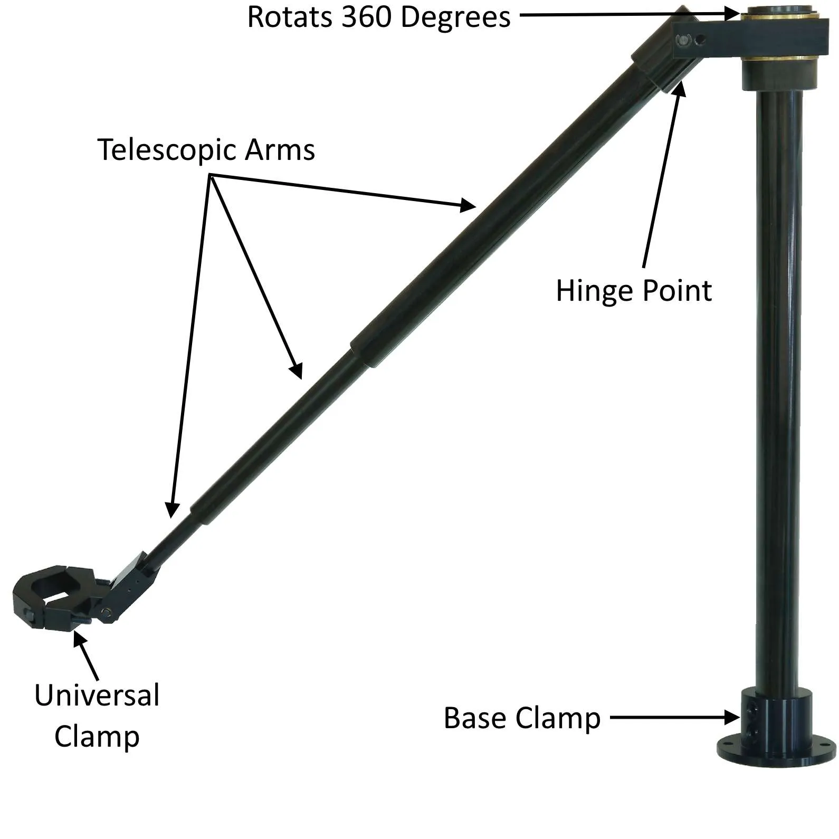

Milestones - Challenging and Stretch Goals
Challenging Goals
Telescopic Arms - Addition of having telescopic arms so the net can have the ability to protract and retract.
Stretch Goals
Drag Sensor and GPS - Installation of drag sensors and GPS to determine when the net is full and determine a path back to the start point respectively.
Full Autonomy and Route Optimization - Develop algorithms for autonomous navigation with dynamic path planning and obstacle avoidance.
Drag Sensors
Telescopic Arms

Slide 7
References
Souza, Danilo Ferreira De, et al. “Efficiency, Quality, and Environmental Impacts: A Comparative Study of Residential Artificial Lighting.” Energy Reports, vol. 5, 2019, pp. 409–424., doi:10.1016/j.egyr.2019.03.009.
Anderson, Donald M, et al. “Progress in Understanding Harmful Algal Blooms: Paradigm Shifts and New Technologies for Research, Monitoring, and Management.” Annual Review of Marine Science, U.S. National Library of Medicine, 2012, pmc.ncbi.nlm.nih.gov/articles/PMC5373096/.
“Control and Treatment.” U.S. National Office for Harmful Algal Blooms, hab.whoi.edu/response/control-and-treatment/.
Daniel worked with algae in high school (tinyurl.com/BioPlankton) What Is the Effect of Light Intensity Measured in Illuminance (lx) on the Rate of Photosynthetic Reaction Based on the Production of Oxygen (%O /s) in Nannochloropsis oculata

Slide 8
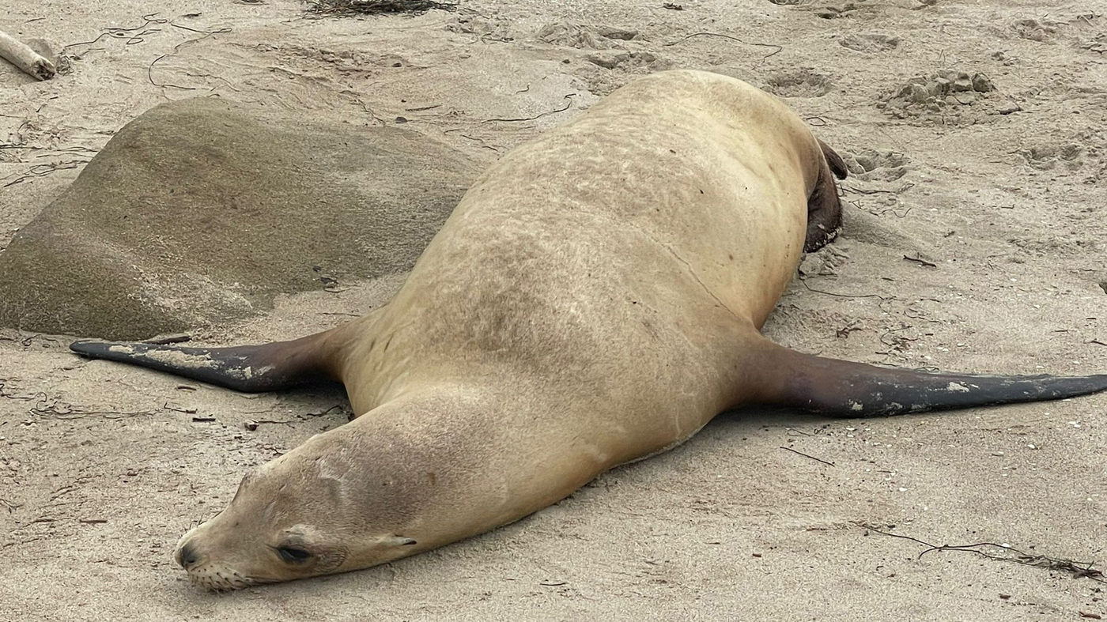
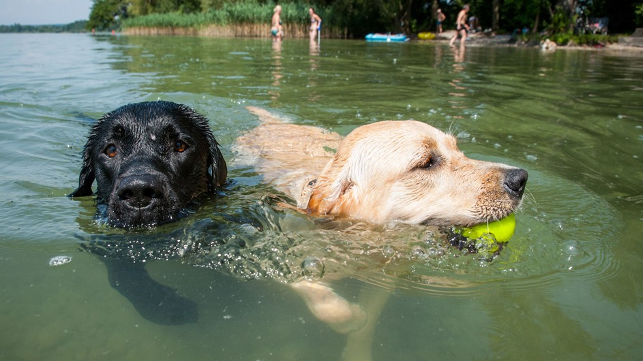
Questions for the audience?
Have you ever seen or even swam with algae?
Have any of your communities been affected by toxic algae blooms?
Do you have any questions for us?
Maybe you have questions for the audience, and/or you can field questions from the audience.
I’m sad about algae

